Slide 1

Test-Driven Development
Learn the "Test First" Approach to Coding
SoftUni Team
Technical Trainers
Software University
https://softuni.bg

Slide 2
Table of Contents
Code and Test
Test-Driven Development
Reasons to Use Test-Driven Development

Slide 3
Have a Question?
sli.do
#java-advanced

Slide 4

Test-Driven Development

Slide 5
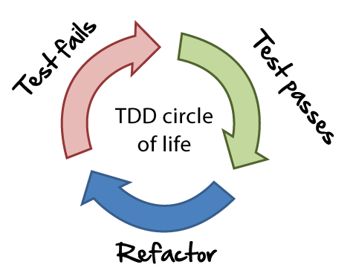
Unit Testing Approaches
"Code First" (code and test) approach
Classical approach
"Test First" approach
Test-driven development (TDD)
5

Slide 6
The Code and Test Approach
Write code
Write unit test
Run and succeed
Time flow

Slide 7
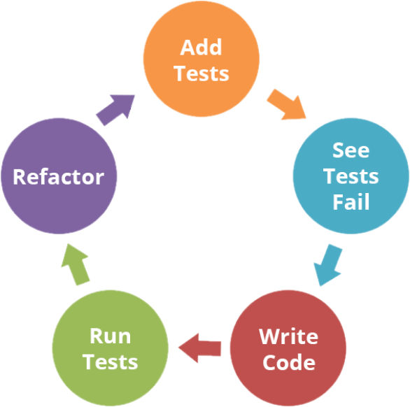
The Test-Driven Development Approach

Slide 8
Test-Driven Development (TDD)
Create a test list
Pick а test
Write test
Compile and fail
Write enough code to compile
Run test and fail
Write code to pass test
Time flow
Remove duplication

Slide 9

Why TDD?
TDD helps find design issues early
Avoids reworking
Writing code to satisfy a test is a focused activity
Less chance of error
Tests will be more comprehensive than if they are written after the code
9

Slide 10

Summary
…
…
…
Code and Test
Write code, then test it
Test-Driven Development
Write tests first
Reasons to use TDD
Prevent some application design flaws
Manage complexity more easily

Slide 11
Questions?
Notes:
11

Slide 12













SoftUni Diamond Partners

Slide 13


Educational Partners

Slide 14
Trainings @ Software University (SoftUni)
Software University – High-Quality Education, Profession and Job for Software Developers
softuni.bg
Software University Foundation
softuni.foundation
Software University @ Facebook
facebook.com/SoftwareUniversity
Software University Forums
forum.softuni.bg
14
Notes:
14

Slide 15

License
This course (slides, examples, demos, exercises, homework, documents, videos and other assets) is copyrighted content
Unauthorized copy, reproduction or use is illegal
© SoftUni – https://about.softuni.bg
© Software University – https://softuni.bg
Notes:
15

